Slide 1
Web Application:
Markdown editor
Node GUI
Django Server
GitHub:
Markdown commit history
Single private repo
HTTPS
Authentication & Permissions:
Users, teams, roles, sessions
HTTPS
Project Services:
Open, save, delete, export
Neon Postgres:
User/team/roles
Project meta data
Parser/Converter:
Markdown ⇄ Node GUI → JSON
PostgreSQL
TLS
GitHub Services:
Markdown Commits
Database Services
App data

Slide 2
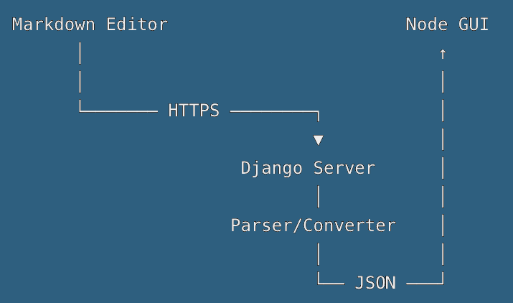

Slide 3
Markdown Editor
Node GUI
HTTPS
Django Server
Parser/Converter
graph data

